Slide 1
Introduction to AI Agents
Prepared by: Muhammad Abdul Qayum
National Textile University, Faisalabad
Ref: Book Building Agents with OpenAI Agents SDK by Henry Habib
Notes:
https://github.com/PacktPublishing/Building-Agents-with-OpenAI-Agents-SDK/tree/main

Slide 2
Cover in this first chapter
Overview of the AI agent system and its strengths and weaknesses compared to more traditional systems
Practical applications of AI agents
How AI agents are built, by understanding their anatomy and different design/framework patterns used to build them
Notes:
Anatomy: a study of the structure or internal workings of something.

Slide 3
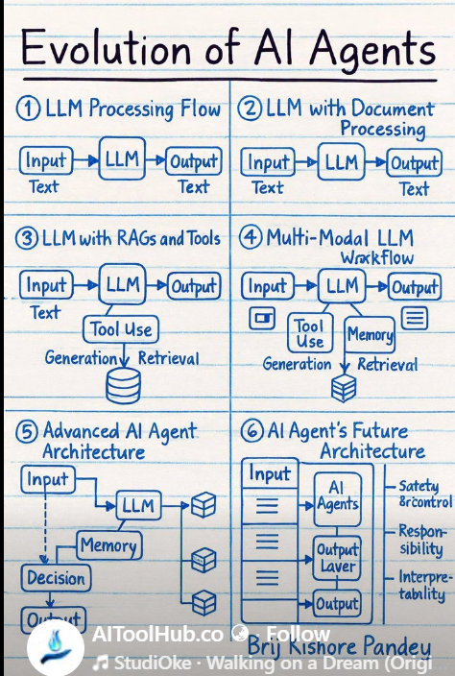

Slide 4
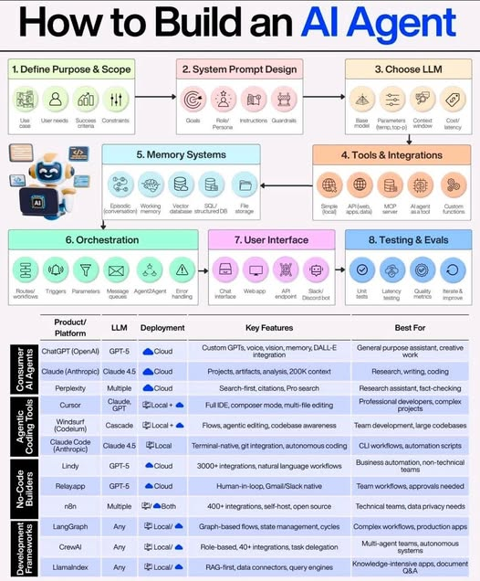

Slide 5
AI Agents: Transforming the Future of Work
Traditional software is deterministic and rigid (if X → Y)
Cannot handle ambiguity or adapt to changing goals
Large Language Models (LLMs) enable AI agents to reason and take actions independently
AI agents complete tasks that were once thought uniquely human
Handle multi-step reasoning and goal-oriented actions
Redefining work: humans and AI collaborate, focusing on creativity and higher-level thinking
Adoption of AI agents is growing and shaping the future of work
Notes:
AI agents are changing the way we work. Software has typically created deterministic (if X, then Y) and rigid systems that cannot address ambiguity or adapt to different goals – but this is changing. With the advancements of large language models (LLMs), intelligent systems are being created that can independently reason through steps and take actions to complete a goal. These AI agents are taking a larger share of work previously thought only a human could do, and it’s just beginning.
By the end of this book, you will become a master at creating AI agents through OpenAI Agents SDK. The best way to learn this is to get your hands dirty and start building AI agent systems using that framework. Before we do this, however, we need to start at the most basic level, which is answering the question, “What is an AI agent?”.

Slide 6
Technical requirements
Operating system: Windows 10/11, macOS, or Linux-based distribution (Ubuntu recommended).
Python version: Python 3.8 or later. You can verify your Python version by running python --version in your terminal or Command Prompt.
OpenAI account: Sign up at https://platform.openai.com/signup.
OpenAI API key: Obtained by creating an account with OpenAI. You will require this to utilize OpenAI Agents SDK.
Code editor: VS Code, PyCharm, or any IDE/editor you prefer.

Slide 7
What is an AI agent?
An AI agent is an intelligent system that can operate independently to accomplish a specific goal by perceiving the world around it and taking action.
Key distinguishing features of an AI agent include its ability to think and reason from a broad and sometimes ambiguous goal,
its ability to create a plan to accomplish that goal, and
its ability to autonomously complete that goal using a set of tools at its disposal that interact with the world.

Slide 8
What is an AI agent?
This is in direct contrast to other conventional software systems that are deterministic (i.e., they follow a strict set of instructions based on a predefined plan) and
cannot reason if situations outside of that plan are encountered. AI agents, on the other hand, can observe their environment, reason about what needs to be done, and act upon it in a continuous manner
Notes:
It’s important to mention that intelligent autonomy comes with the need for safeguards. An autonomous agent might make a poor decision if its “brain” (the AI model) is misinformed. We will later discuss how to guide and constrain agents (through prompt instructions and guardrails) to ensure their autonomy is exercised responsibly. The key takeaway here is that AI agents bring a level of smart, goal-directed independence that sets them apart from traditional automated systems.

Slide 9
AI agent may hallucinate and perform nonsensical actions.

Slide 10
Practical applications of AI agents
Productivity gains
AI agents is improved productivity, primarily through replacing or augmenting human work that traditional software systems cannot replace
Better interactivity
AI agents receive user requests through natural language and contain the necessary tooling to perform SQL queries
New businesses
entire new businesses and strategies are being built from AI agents.
Notes:
The most obvious and immediate motivation for AI agents is improved productivity, primarily through replacing or augmenting human work that traditional software systems cannot replace or augment. By handling these tasks autonomously, AI agents free up humans to focus on higher-level, more strategic work and creativity
Lantern to expedite document review

Slide 11
Practical applications of AI agents
Customer support as an example. Traditionally, a customer support center might require dozens or hundreds of human agents to handle queries.
Software development is also a typical function where AI agents are swarming. It is well known that AI coding assistants such as GitHub Copilot have been proven to help developers complete tasks 55% faster
HR, AI agents can automate candidate screening, predict employee attrition, and personalize onboarding processes
Notes:
swarming
/ˈswɔːmɪŋ/
adjective
adjective: swarming
moving in or forming a large or dense group.
"swarming locusts"

Slide 12
Build methodology of AI agents

Slide 13
Anatomy of an AI agent
AI agents follow a typical pattern and can be broken down into three fundamental components.
Model: This is the brain of the operations. It interprets input, reasons about actions, and generates outputs.
Tooling interface: This is the hands and eyes. It provides the agent with the ability to act, such as sending emails or searching the web via APIs or local function calls.
Memory and knowledge: This is the reference textbook. It contains information that helps the AI agent perform its tasks, such as databases, documents, and so on.

Slide 14
Model
AI agents are powered by an underlying model that enables them to understand inputs, create action, generate action inputs, review action responses, and iterate that process until its goal is achieved. The core model does not technically need to be an LLM
Cost: LLMs vary significantly in their cost.
Latency: LLMs vary in their speed to respond.
Performance: Certain LLMs are great at coding tasks, creative exercises. Certain LLMs are multi-modal.
Bias: LLMs also differ in their knowledge and leanings
Notes:
Certain aspects of performance and bias, such as knowledge cut-off dates and political leanings, can be resolved by tactics such as retrieval augmented generation (RAG), nuanced prompting, or post-train refinements. These will be covered later

Slide 15
Model
AI agents are powered by an underlying model that enables them to understand inputs, create action, generate action inputs, review action responses, and iterate that process until its goal is achieved. The core model does not technically need to be an LLM
Cost: LLMs vary significantly in their cost.
Latency: LLMs vary in their speed to respond.
Performance: Certain LLMs are great at coding tasks, creative exercises. Certain LLMs are multi-modal.
Bias: LLMs also differ in their knowledge and leanings
Notes:
Certain aspects of performance and bias, such as knowledge cut-off dates and political leanings, can be resolved by tactics such as retrieval augmented generation (RAG), nuanced prompting, or post-train refinements. These will be covered later

Slide 16
Model
models used to power AI agents are not purpose-built or trained for each AI agent
Instead, these are general-purpose pre-trained models
just given special instructions to behave like agents.
These “instructions” are provided to the model by defining a system prompt
A good analogy is when you write a system prompt, you are defining the model’s identity and purpose

Slide 17
Control logic framework
An AI agent’s control logic framework enables
it to observe,
reason, and
act repeatedly until it reaches a goal
—a process managed by the agentic framework code, not the model itself.

Slide 18
Control logic framework
Read user's goal and create action plan
For each step in action plan:
Create action inputs
Execute action
Get result
Add result to memory
Modify action plan if necessary or if goal not achieved
If goal is achieved:
Return output to user

Slide 19
Control logic framework
Agentic frameworks vary in approach but generally follow a plan-and-execute structure.
Common examples include Chain-of-Thought (CoT) and ReAct.
Some frameworks even add a self-evaluation step, where the agent first generates an answer and then acts as a judge to assess its own response and reasoning..

Slide 20
Tooling interface
Definition: The tooling interface allows an AI agent to interact with the outside world.
Basic LLM Interaction: Normally, an LLM communicates via text, image, or audio outputs, generating tokens through deep neural networks.
Outside World: Refers to external applications — such as email, web search, or computer control.
Purpose: Enables the AI agent to take actions beyond conversation — acting as its hands and eyes.
Key Role: Essential for connecting reasoning (LLM) with real-world execution (tools).
Notes:
critical requirement for an AI agent that we previously discussed is its ability to interact with the outside world, which is called its tooling interface. Normally, an LLM interacts with a user through text, image, and audio outputs, producing tokens from its vast deep learning neural network. The outside world refers to the environment beyond it, which typically refers to other applications such as email, searching the web, or controlling your computer. This enables AI agents to do stuff and serves as its hands and eyes.

Slide 21
Tooling interface
For example, the framework for an AI agent that assists with email tools may include the following actions (again, in pseudocode):
Action #1: Send an email
Description: Sends an email to a user
Parameters: to_email_address, email_subject, email_body
Action #2: List all emails
Description: Lists all emails, including email_id
Parameters: search_term (optional)
Action #3: Read an email
Description: Returns the content of an email
Parameter: email_id

Slide 22
Tooling interface
When an AI agent is created with these tools(mentioned in previous slide), its model and control logic framework decides when to use these actions and determines the correct inputs for these actions.
For example, an AI agent may be given the task of finding all emails related to the coffee expansion proposal, summarizing them, and sending the summary to the user’s manager.
In that case, the AI agent would first call the List all emails action with the search term coffee expansion proposal or something similar, use the Read an email action to read them, summarize them using the LLM, and then use the Send an email action to send the summary.

Slide 23
Tooling interface
They recognize available tools automatically by including their names, definitions, and parameters in the system prompt.
They execute tool actions automatically, either locally (function calls on the same machine) or remotely (API calls to a server).
They receive and forward tool outputs back to the model through the agentic framework.
Since tools are essential for enabling real-world interactions, designing and managing tools—including their logic, parameters, registration, selection, and error handling—is a core skill in building AI agents and deserves dedicated focus.

Slide 24
Memory and knowledge

Slide 25
Memory and Knowledge in AI Agents
Memory and knowledge are separate but related concepts in AI agents.
Both provide relevant context to the model based on the user’s overall request.
This context improves the intelligence and effectiveness of the AI agent.
Memory allows the agent to remember information from current and past interactions.
There are two main types of memory, which are discussed further in later sections.
Notes:
Memory and knowledge with respect to AI agents are separate but related concepts. The purpose of both is to provide the relevant context to the model in light of the user’s overall request. This improves the AI agent’s intelligence and effectiveness. Let’s talk about each concept and how it’s used mechanically to provide more context to the AI agent.
Memory refers to the AI agent remembering relevant information from current and previous interactions with the user. There are typically two types of memory, as discussed in the following subsections.

Slide 26
Working Memory in AI Agents
Definition: Working memory stores information from the current interaction or session of the AI agent.
Example:
In a chat, if you ask “How hot is the sun?” followed by “How big is it?”, the agent knows “it” refers to the sun using working memory.
Mechanism:
Recent conversation history is included in the prompt sent to the model.
This allows the LLM to maintain context and give coherent follow-up responses.
Working memory is often embedded into system instructions for consistency.

Slide 27
Working Memory in AI Agents
Limitations:
Working memory has a finite size (e.g., GPT-4o ≈ 128K tokens).
When full, older messages drop out as new ones are added.
Techniques like context windows or sliding windows are used to retain the most relevant

Slide 28
Long-Term Memory in AI Agents
Definition: Long-term memory stores information from previous sessions of the AI agent.
Purpose:
Converts a stateless system (no recall of past interactions) into a stateful one (context-aware).
Allows each new request to be influenced by information from past conversations.
Intelligent Behavior:
AI agents that appear more intelligent and personalized usually include long-term memory.
Example: An AI email assistant that remembers your writing style or preferences across sessions.
Mechanism:
The agent stores interaction data in a database.
It can retrieve that stored information later when needed.
Both storing and recalling memories are typically handled through tool interactions (tools designed for memory management).
Notes:
Long-term memory is information stored from the interaction history of previous sessions of the AI agent. This enables an AI agent to go from a classically stateless experience (where each request is handled independently of prior interactions) to a stateful experience (each request is colored by information retrieved from previous interactions). AI agents that are deemed to be intelligent from a consumer point of view typically have some implementation of long-term memory. For example, consider an AI agent that helps you write emails.
Mechanically, this is done by the AI agent storing information from interactions in a database, which it can then read later, both of which can be done through a tool interaction. For example, the AI agent may have the following tooling, which enables it to store and recall memories:

Slide 29
Long-Term Memory in AI Agents
Definition: Long-term memory stores information from previous sessions of the AI agent.
Purpose:
Converts a stateless system (no recall of past interactions) into a stateful one (context-aware).
Allows each new request to be influenced by information from past conversations.
Notes:
Long-term memory is information stored from the interaction history of previous sessions of the AI agent. This enables an AI agent to go from a classically stateless experience (where each request is handled independently of prior interactions) to a stateful experience (each request is colored by information retrieved from previous interactions). AI agents that are deemed to be intelligent from a consumer point of view typically have some implementation of long-term memory. For example, consider an AI agent that helps you write emails.
Mechanically, this is done by the AI agent storing information from interactions in a database, which it can then read later, both of which can be done through a tool interaction. For example, the AI agent may have the following tooling, which enables it to store and recall memories:

Slide 30
Long-Term Memory in AI Agents
Intelligent Behavior:
AI agents that appear more intelligent and personalized usually include long-term memory.
Example: An AI email assistant that remembers your writing style or preferences across sessions.
Mechanism:
The agent stores interaction data in a database.
It can retrieve that stored information later when needed.
Both storing and recalling memories are typically handled through tool interactions (tools designed for memory management).
Notes:
Long-term memory is information stored from the interaction history of previous sessions of the AI agent. This enables an AI agent to go from a classically stateless experience (where each request is handled independently of prior interactions) to a stateful experience (each request is colored by information retrieved from previous interactions). AI agents that are deemed to be intelligent from a consumer point of view typically have some implementation of long-term memory. For example, consider an AI agent that helps you write emails.
Mechanically, this is done by the AI agent storing information from interactions in a database, which it can then read later, both of which can be done through a tool interaction. For example, the AI agent may have the following tooling, which enables it to store and recall memories:

Slide 31
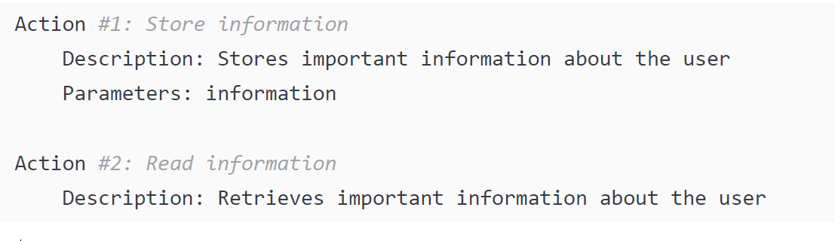
Long-Term Memory in AI Agents
Mechanism:
The agent stores interaction data in a database.
It can retrieve that stored information later when needed.
Both storing and recalling memories are typically handled through tool interactions (tools designed for memory management).
Notes:
The implementation of memory and knowledge differ based on the agentic framework and the model chosen. In most circumstances, working memory and training knowledge are typical – no extra functionality is required to enable these components. Long-term memory or relevant knowledge, however, does require dedicated tooling, which can increase the complexity of AI agents. These aspects will be discussed in a dedicated chapter.

Slide 32
Knowledge

Slide 33
Knowledge in AI Agents
Definition: Knowledge is the AI agent’s ability to recall information from a stored knowledge base.
Difference from Memory:
Unlike memory, knowledge is not derived from past user interactions.
It comes from external sources such as documents, databases, files, or text corpora(a collection of written texts, especially the entire works of a particular author or a body of writing on a particular subject)
Purpose: Provides relevant factual or domain-specific context to enhance the agent’s reasoning and accuracy.
Types: There are two main types of knowledge, explained further in later sections.
Notes:
corpora(a collection of written texts, especially the entire works of a particular author or a body of writing on a particular subject)
A
corpus is a large, principled collection of texts or language data used for research, analysis, and language study, while corpora is its plural form. These collections can range from small, like a class's essays, to massive, like the entire internet, and are frequently stored in machine-readable databases for quantitative analysis of language use

Slide 34
1. Training Knowledge in AI Agents
Definition: Training knowledge is the information embedded in the model from its training data — often called general or baked-in knowledge.
Example: An LLM can answer “How big is the sun?” because that fact exists in the text corpus(large collection of text) it was trained on.
Advantages:
Contains vast amounts of general knowledge learned during training.
Can recall and adapt this knowledge quickly to user queries.
Limitations for AI Agents:
Not useful for real-time or contextual reasoning.
Cannot recall information beyond its training cut-off date.
Cannot access private or dynamic data unavailable during training.
Often, AI agents are instructed to ignore training knowledge to avoid outdated or irrelevant responses.
Notes:
Training knowledge refers to information that is inherently stored in the model through its training data. For example, all LLMs can easily answer the question How big is the sun? as the information to answer that question exists in the corpus of text on which the LLM was trained. This is also referred to as general knowledge. It’s the “baked-in” knowledge that an LLM has consequent to how it was trained.
An LLM’s training knowledge is often its source of greatest benefit – being able to recall terabytes of useful general knowledge in a few seconds and adapt it to the user’s request is powerful. From an AI agent’s point of view, however, this is not that helpful. An AI agent is typically not meant to recall general knowledge; an LLM connected to a chat interaction can serve that purpose much better. In addition, an LLM cannot recall information past its training knowledge cut-off date, nor can it recall information that is not publicly available – two elements that are needed to build effective and impactful AI agents. In fact, we generally purposely instruct the model to ignore any of its training knowledge when generating a response.

Slide 35
2. Retrieved Knowledge in AI Agents
Definition: Retrieved knowledge is information fetched in real time from a knowledge store based on the user’s request.
Difference from Training Knowledge:
Training knowledge is static and fixed at training time.
Retrieved knowledge is dynamic and updated during runtime.
Sources:
Documents, databases, file repositories, or web sources.
Only relevant information is retrieved based on the user’s context.
Notes:
Retrieved knowledge refers to information that is retrieved in real time from a knowledge store based on the user’s request. Unlike training knowledge, which is static and fixed at the time the model was trained, retrieved knowledge is dynamic and adaptable. The knowledge store can be documents, databases, and more. The important factor here is that only the relevant information based on the user’s context is retrieved and added to the model during the AI agent runtime.
Mechanically, this is achieved through tooling similar to long-term memory. The tooling enables the AI agent with retrieval mechanisms such as a vector database (using the RAG pattern), structured APIs, file repository searches such as SharePoint or Google Drive, and web search. The AI agent uses the user’s input to search these sources for relevant documents or records, which are then supplied as context to the model for response generation.

Slide 36
2. Retrieved Knowledge in AI Agents
Mechanism:
Achieved using tooling similar to long-term memory.
Employs retrieval mechanisms such as:
Vector databases using the RAG (Retrieval-Augmented Generation) pattern
Structured APIs
File searches (e.g., SharePoint, Google Drive)
Web search
Purpose: Retrieved knowledge provides up-to-date, context-specific information that enhances the AI agent’s accuracy and relevance during responses.

Slide 37
2. Retrieved Knowledge
There are many benefits to integrating retrieved knowledge into an AI agent. In particular, an AI agent can do the following:
Answer questions with up-to-date or proprietary content
Provide citations or references for traceability (whereas it’s extremely difficult for an LLM to provide a source with its trained knowledge)

Slide 38
Significance of Retrieved Knowledge in AI Agents
Importance: Retrieved knowledge is essential for making AI agents practical, accurate, and impactful in real-world scenarios.
Examples:
An HR AI agent uses knowledge retrieval to answer questions about vacation policies, benefits, or sick leave.
A Sales AI agent searches a CRM system to find customer notes and history relevant to the query.
Core Insight: Effective AI agents depend on retrieval mechanisms to access organization-specific or dynamic information beyond their training data.
Next Step in Design: Understanding memory and knowledge allows us to explore how different agent design patterns integrate:
The model (LLM)
The tooling interface
The memory and knowledge components
Notes:
This type of relevant knowledge is crucial for making AI agents useful and impactful. Consider an AI agent that serves as the HR role for an organization. The only way it can answer questions about the organization’s vacation policy, benefits, sick time, and so on is by a method of knowledge retrieval. A sales AI agent may search through a company’s customer relationship management (CRM) system to find notes on a customer the user is asking about.
Now that we understand the anatomy of an AI agent, we can distinguish between different design and implementation patterns in terms of how they tackle the model, the tooling interface, and the memory and knowledge components.

Slide 39
Design patterns

Slide 40
AI Agent Design Patterns
Common Structure: All AI agent design patterns share three core components:
Model (the LLM)
Tooling Interface
Memory & Knowledge System
Key Differences:
They vary in how they implement and control the logic framework.
They differ in their tooling sophistication and coordination methods.
Main Design Patterns:
ReAct (Reason + Act)
CoT (Chain of Thought)
Planner–Executor
Hierarchical / Multi-Agent Systems

Slide 41
Chain of Thought (CoT) Pattern
CoT simply encourages the model to produce a step-by-step reasoning trace before generating a final answer.
A literal interpretation of it would be to tell someone to think about a problem,
create a plan on how they are going to solve it, and then take the steps to solve it.
One limitation of CoT is that it’s unable to take action and, more importantly, unable to adapt its plan based on the results of actions.
Notes:
CoT simply encourages the model to produce a step-by-step reasoning trace before generating a final answer. A literal interpretation of it would be to tell someone to think about a problem, create a plan on how they are going to solve it, and then take the steps to solve it. One limitation of CoT is that it’s unable to take action and, more importantly, unable to adapt its plan based on the results of actions.

Slide 42
ReAct (Reasoning + Acting)
ReAct is a pattern that we mentioned and described in pseudocode earlier.
This design pattern enforces an AI agent to iteratively reason about the problem and choose a tool or action to take, feeding the result back into the continuous loop until its goal is achieved.
The difference between ReAct and CoT is in its ability to act and then adjust its plan based on the results of that action. This is best for real-world agents that need to reason and interact with tools to solve complex tasks.
This pattern is most often the go-to for most traditional AI agents.

Slide 43
Planner-execution
The planner-execution pattern separates the system performing the planning from the system performing the execution.
An agent first generates a high-level plan and then another agent (or multiple agents) executes each task in that plan.
This pattern works well for very long-term complex tasks or tasks that can easily be modularized and delegated to sub-agents.

Slide 44
Hierarchical/multi-agent
Definition:
Divides tasks among multiple specialized agents, each an expert in a particular domain.
Supports distributed execution, enabling simultaneous task completion.
Analogy:
Like a company with a CEO delegating tasks to specialized workers (CMO, COO, CFO, etc.).
Example:
AI agent handling customer complaints:
Manager agent: Receives complaint and creates action plan.
Specialized agents:
Customer agent: Looks up customer information.
Compliance agent: Reviews policies.
Response agent: Drafts reply.
Each agent has its own model, tooling, and memory/knowledge.

Slide 45
Hierarchical/multi-agent
These patterns are not mutually exclusive. In fact, most real-world agents, especially those built with the frameworks briefly discussed next, tend to blend these approaches depending on the complexity of the task and the tools available. The OpenAI Agents SDK framework, for example, combined ReAct and hierarchical/multi-agent patterns.

Slide 46
Summary
Integration of Patterns:
AI agent design patterns are not mutually exclusive.
Real-world agents often blend multiple patterns based on task complexity and available tools.
Example: OpenAI Agents SDK combines ReAct and hierarchical/multi-agent patterns.
Core Concepts Learned:
AI agents are intelligent systems that can reason, plan, and interact with tools to achieve goals independently.
Unlike traditional automation, they handle ambiguity and adapt dynamically.
Benefits include:
Accelerating organizational workflows.
Enabling direct interaction with tools and data.
Creating entirely new business opportunities.
Notes:
Note
These patterns are not mutually exclusive. In fact, most real-world agents, especially those built with the frameworks briefly discussed next, tend to blend these approaches depending on the complexity of the task and the tools available. The OpenAI Agents SDK framework, for example, combined ReAct and hierarchical/multi-agent patterns.
In this chapter, we learned about AI agents, their practical applications, and their build methodology.
AI agents are intelligent systems capable of independently achieving goals by reasoning, planning, and interacting with the world through tools. Unlike traditional automation systems that require rigid, predefined instructions, AI agents can handle ambiguity and dynamically adjust their steps and actions based on the overall goal.
AI agents help organizations work faster by augmenting or replacing work traditionally done by humans. They also enable individuals to directly interact with tools and data without friction. Finally, organizations are creating entirely new businesses by leveraging the AI agent architecture.
The core anatomy of an AI agent consists of the following: the model, the tooling interface, and its memory and knowledge component. Design patterns guide how these components work together. For instance, ReAct allows agents to reason and adapt with each action step, while multi-agent systems distribute tasks across specialized sub-agents for efficiency. Various frameworks implement these concepts differently.
Among these frameworks, OpenAI Agents SDK stands out for its minimal, extensible architecture, built-in observability, and enterprise-grade features, making it a robust choice for building production-grade AI agents.

Slide 47
Summary
Anatomy of an AI Agent:
Model (LLM)
Tooling Interface
Memory & Knowledge Component
Design Patterns Role:
Guide how components work together.
Examples:
ReAct: Reason and adapt with each action.
Multi-Agent: Distribute tasks across specialized sub-agents.
Framework Highlight:
OpenAI Agents SDK: Minimal, extensible, enterprise-grade, and production-ready framework for AI agents.
Notes:
Note
These patterns are not mutually exclusive. In fact, most real-world agents, especially those built with the frameworks briefly discussed next, tend to blend these approaches depending on the complexity of the task and the tools available. The OpenAI Agents SDK framework, for example, combined ReAct and hierarchical/multi-agent patterns.
In this chapter, we learned about AI agents, their practical applications, and their build methodology.
AI agents are intelligent systems capable of independently achieving goals by reasoning, planning, and interacting with the world through tools. Unlike traditional automation systems that require rigid, predefined instructions, AI agents can handle ambiguity and dynamically adjust their steps and actions based on the overall goal.
AI agents help organizations work faster by augmenting or replacing work traditionally done by humans. They also enable individuals to directly interact with tools and data without friction. Finally, organizations are creating entirely new businesses by leveraging the AI agent architecture.
The core anatomy of an AI agent consists of the following: the model, the tooling interface, and its memory and knowledge component. Design patterns guide how these components work together. For instance, ReAct allows agents to reason and adapt with each action step, while multi-agent systems distribute tasks across specialized sub-agents for efficiency. Various frameworks implement these concepts differently.
Among these frameworks, OpenAI Agents SDK stands out for its minimal, extensible architecture, built-in observability, and enterprise-grade features, making it a robust choice for building production-grade AI agents.

Slide 48
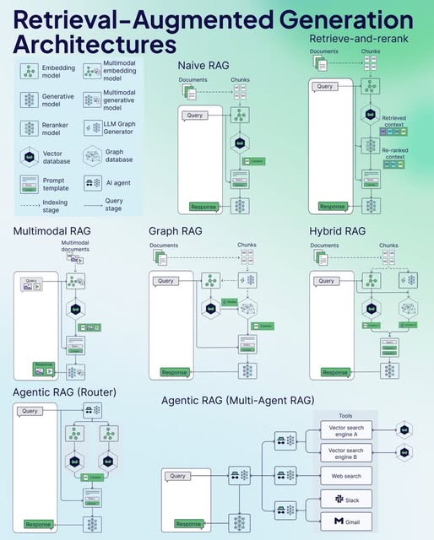

Slide 49
